Slide 1
Types of Data/ Data Characteristic

Slide 2
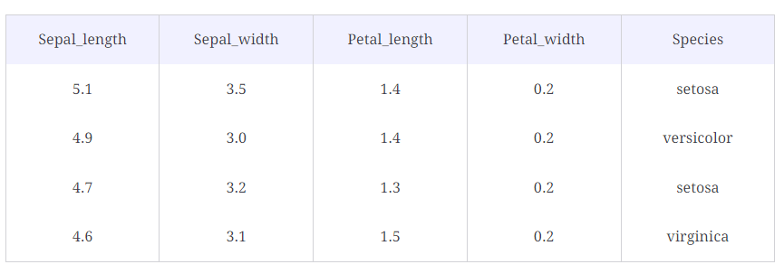
Structured vs. Semi-Structured vs. Unstructured Data
Structured Data
It comes with a predefined format and structure. Structured Data is usually stored in Relational Databases. It is easy to deal with in the Data Science domain.

Slide 3
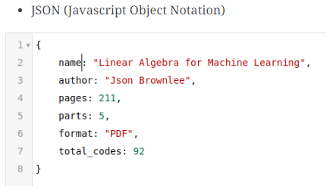
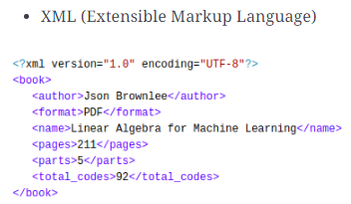
Semi-Structured Data
It comes with a predefined format and structure but is not stored in the Relational Database.

Slide 4
Unstructured Data
It does not have a specific format and lacks structure. It is the type of data that presents many challenges to handle in the Data Science domain
Examples:
Images
Videos
Speech
web logs

Slide 5
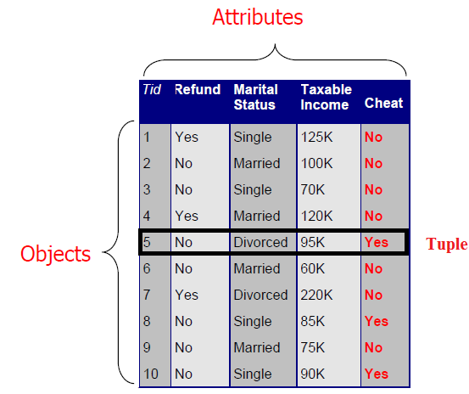
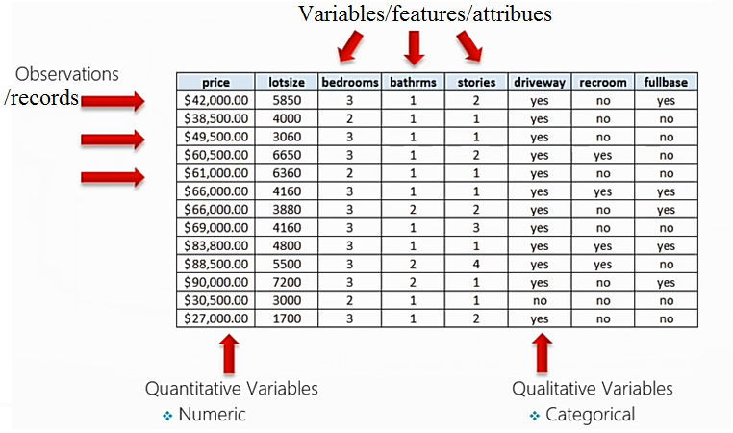
Data
Collection of objects and their attributes

Slide 6
describe the dataset
Need to know in what form the data is present to analyze it properly and apply different statistical methods on it
What do your records represent?
What does each attribute mean?
What type of attributes?
Categorical
Numerical

Slide 7
Data Types

Slide 8
Categorical data
Categorical data as the name suggests, represent categories or characteristics such as gender, language, level of education, marital status, the genre of a movie, etc
It is also known as Qualitative Data.
We can associate numerical values with categorical data, but they would not have any mathematical meaning, e.g., 0/1 for male/female.

Slide 9
Categorical data 1. Nominal data
Nominal data is categorical data that has no order
It can be thought of as labels, have no quantitative value
Gender of a person as male or female
Language a person speaks
Eye color
Nominal Data can be dealt with using frequencies, proportions, pie charts, bar plots, etc.

Slide 10
Categorical data 2. Ordinal data
Ordinal data is categorical data that has a sense of order to it
Ordinal values represent discrete and ordered units
It is therefore nearly the same as nominal data, except that it’s ordering matters
Happiness level of a customer
Level of education (Higher, Secondary, Primary)
Rating of a movie on a scale of 0−5
Height in {tall, medium,short}
rRnkings (e.g. Taste of potato chips on scale from 1-10)
Letter grades in exam (A,B,C,D etc.)
We can summarize ordinal data with percentiles, frequencies, median, mean, etc. For visualization, we can use pie charts and bar charts.

Slide 11
Categorical data 3. Binary
Special type of categorical data called binary
Binary data types only have two values – yes or no.
This can be represented in different ways such as “True” and “False” or 1 and 0
Binary data is used heavily for classification machine learning models.

Slide 12
Data Types

Slide 13
Numerical /Quantitative data
Expressed as a number, so it can be quantified
Represents the numerical value integer or real values
Height of a person
Price of a product
IQ of a person
Number of lessons in this course
Discrete data
Continuous data
Notes:
Numerical /Quantitative data:
(how much, how many, how often)

Slide 14
Numerical Data 1. Discrete data
Has only a finite or countably infinite set of values
Data is discrete if the values of data are distinct and separate
Data can only take on certain values
This type of data can’t be measured but it can be counted
Zip codes
Set of words in a collection of documents
Number of heads in 100 tosses of a coin flip
Number of students in a classroom
Number of cars in a showroom
Often represented as integer variables
We can use statistical methods such as mean, median, quartiles, Box plots, and Histograms to describe numerical data.

Slide 15
Numerical /Quantitative data (Cont.) 2. Continuous data
Continuous data cannot be counted, but it can be measured, It represents measurements
Market share Price (Money)
Height/weight of a person
Amount of rainfall
Speed of a car
Wi-Fi Frequency
It can be divided into further meaningful parts
Has real numbers as attribute values

Slide 16
Continuous data 1. Interval Data
The data can be categorized and ranked and evenly spaced
Interval-scaled attributes are measured on a scale of equal-size units
The values of interval-scaled attributes have order and can be positive, 0, or negative.
Thus, in addition to providing a ranking of values, such attributes allow us to compare and quantify the difference between values
temperatures in celcius or Fahrenheit
calendar dates, the years 2002 and 2010 are eight years apart

Slide 17
Continuous data 2. Ratio data
A ratio-scaled attribute is a numeric attribute with an inherent zero-point.
That is, if a measurement is ratio-scaled, we can speak of a value as being a multiple (or ratio) of another value
In addition, the values are ordered, and we can also compute the difference between values
Unlike temperatures in Celsius and Fahrenheit, the Kelvin (K) temperature scale has what is considered a true zero-point (0◦K = −273.15◦C): It is the point at which the particles that comprise matter have zero kinetic energy.
Other examples of ratio-scaled attributes include count attributes such as years of experience (e.g., the objects are employees) and number of words (e.g., the objects are documents).

Slide 18
Properties of attribute values:
The type of an attribute depends on which of the following properties it possesses:
Distinctness: = 
Order: < >
Addition: + -
Multiplication: * /
Nominal attribute: distinctness
Ordinal attribute: distinctness & order
Interval attribute: distinctness, order & addition
Ratio attribute: all 4 properties

Slide 19
Data Quality
Data quality is a measure of the condition of data based on factors such as accuracy, completeness, consistency, reliability and whether it's up to date
Some of the most common issues affecting data quality are inconsistent formatting of dates and numbers, unusual character sets and symbols, duplicate entries, and different languages and measurement units
Measuring data quality levels can help organizations identify data errors that need to be resolved and assess whether the data in their IT systems is fit to serve its intended purpose
High-quality data is the foundation of all digital business
A multi-dimensional measure of data quality:
A well-accepted multi-dimensional view:
accuracy, completeness, consistency, timeliness, believability, value added, interpretability, and accessibility

Slide 20
Data Quality
Accuracy (Is the information correct in every detail)
As the name implies, this data quality characteristic means that information is correct. There is no error in it. The data should reflect actual, real-world scenarios. Accuracy is a crucial data quality characteristic because inaccurate information can cause significant problems with severe consequences e.g – if there’s an error in a customer’s bank account, it could be because someone accessed it without his knowledge
Completeness (How comprehensive is the information)
Data completeness is how exhaustive a dataset is. Completeness is a measure of the data’s ability to effectively deliver all the required values that are available. It refers to how comprehensive the information is. If information is incomplete, it might be unusable.
Consistency (Does the information contrdict other trusted resourses?)
Data consistency refers to the uniformity of data as it moves across networks and applications. The same data values stored in difference locations should not conflict with one another.

Slide 21
Quality of data
Relevance (Do you really need this information)/Timeliness (How up-to-date is information)
Data relevance is a more subjective measure of data quality. It looks at whether data is sufficiently complete, uniform, consistent (and so on) to fulfill its given task. Another aspect of data relevance, though, is timeliness.Timely data is data that is available when it is required. Data may be updated in real time to ensure that it is readily available and accessible. The timeliness of information is an important data quality characteristic, because information that isn’t timely can lead to people making the wrong decisions. In turn, that costs organizations time, money, and reputational damag
Interpretability
It reflects how easy the data are understood.

Slide 22
Step 2: To explore the dataset
Preliminary investigation of the data to better understand its specific characteristics
It can help to answer some of the data mining questions
To help in selecting pre-processing tools
To help in selecting appropriate data mining algorithms
Things to look at
Class balance
Dispersion of data attribute values
Skewness, outliers, missing values
Attributes that vary together
Visualization tools are important
Histograms, scatter plots

Slide 23
Useful statistics
Discrete attributes
Frequency of each value
Mode = value with highest frequency
Continuous attributes
Range of values, i.e. min and max
Mean (average) ,
Sensitive to outliers
Median
Better indication of the ”middle” of a set of values in a skewed distribution
Skewed distribution
mean and median are quite different

Slide 24
THAT’S IT FOR TODAY!

